Slide 1
ANITA
UPDATE 26MAR2019

Slide 2
(Initial) overview of process
A.
Receiving Data
B.
Create multi-market scraper
C.
Create API
(gain insights)

Slide 3
(Renewed) overview of process
A.
Receiving Data
&
Extract Data
B.
Create multi-market scraper
C.
Create API
(gain insights)

Slide 4
Create multi-market scraper
Phase 1
Import & sort files
Phase 2
Scrape (new) files
Phase 3A
Merge with existing information
Phase 3B
Export JSON

Slide 5
Phase 1 Import & sort files
Input
Determine market & date
Market: scraped
Structure folders
Create new folders to structure. Move folders here
HTML files structured in folders
Date: above mentioned folder

Slide 6
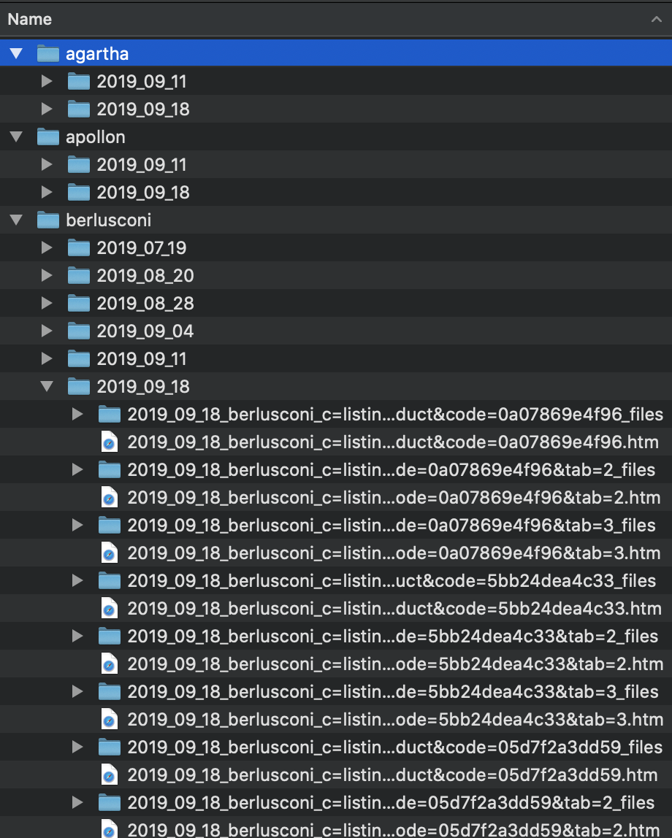
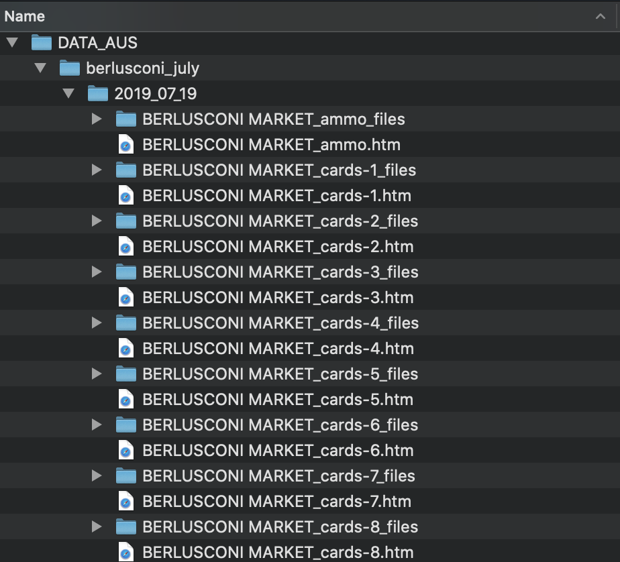
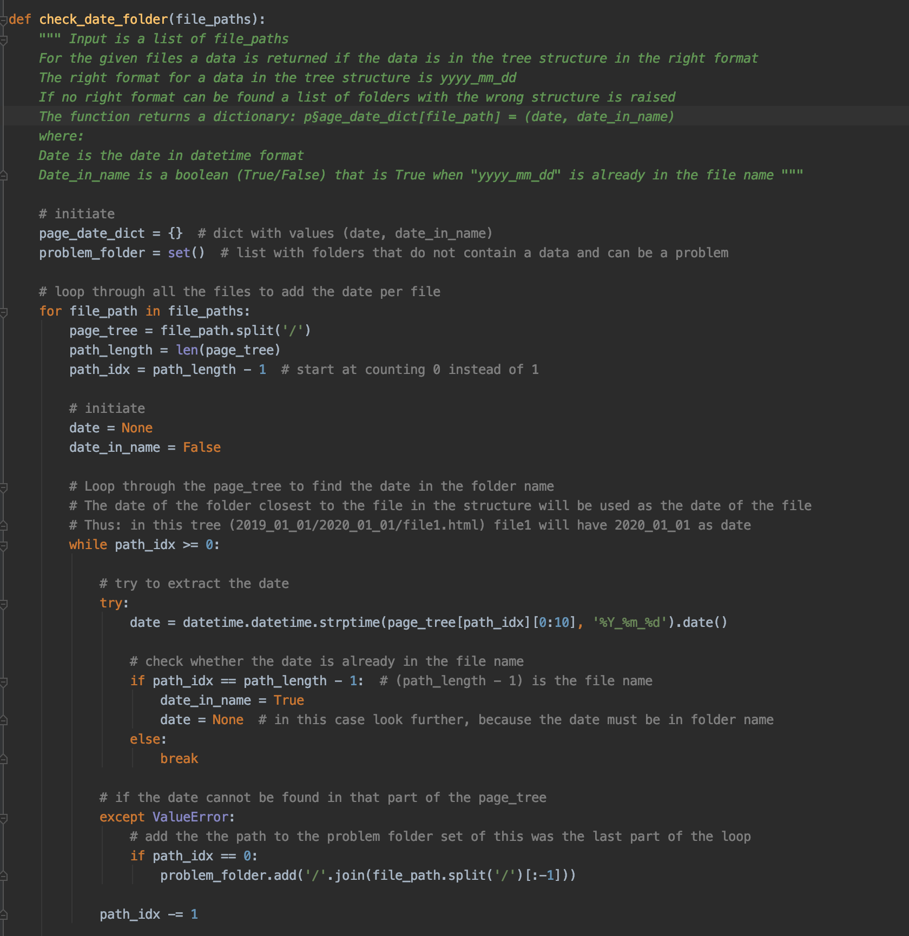
Phase 1 Import & sort files
Input
Determine market & date
Market: scraped
Structure folders
Create new folders to structure. Move folders here
HTML files structured in folders
Date: above mentioned folder

Slide 7
Phase 2 Scrape files
Scrapes per file
Now in data:
Agartha
Apollon
Berlusconi
Drugs & Medicine
Tochka
More (surface web) markets will follow

Slide 8
Phase 2 Scrape files – Scraped features
Product:
Product_name
Vendor
Ships_from
Ships_to
Price
Info
Vendor:
Vendor_name
Score
registration
Las_login
Sales
Info
Product feedback:
Score
Message
Date
User
Vendor feedback:
Score
Message
Date
Product
User
Deals

Slide 9
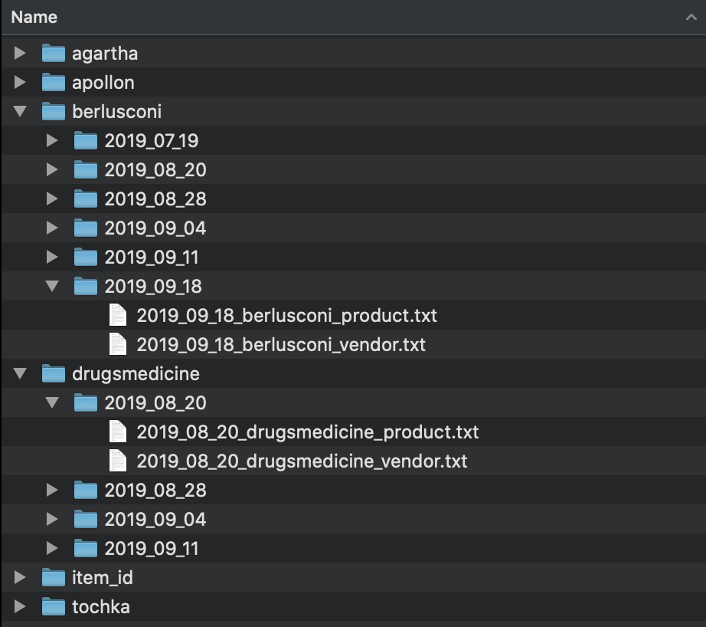
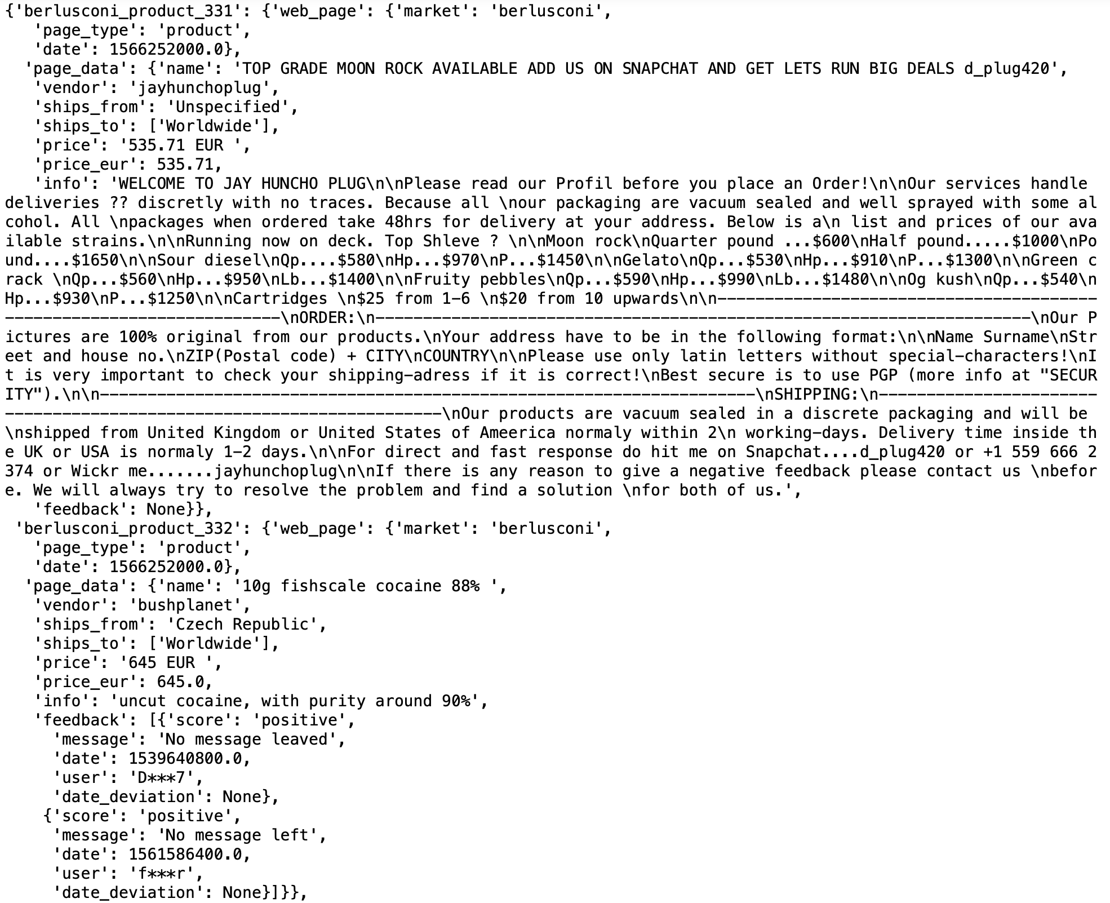
Phase 3A & B From scraped data -> structured JSON

Slide 10
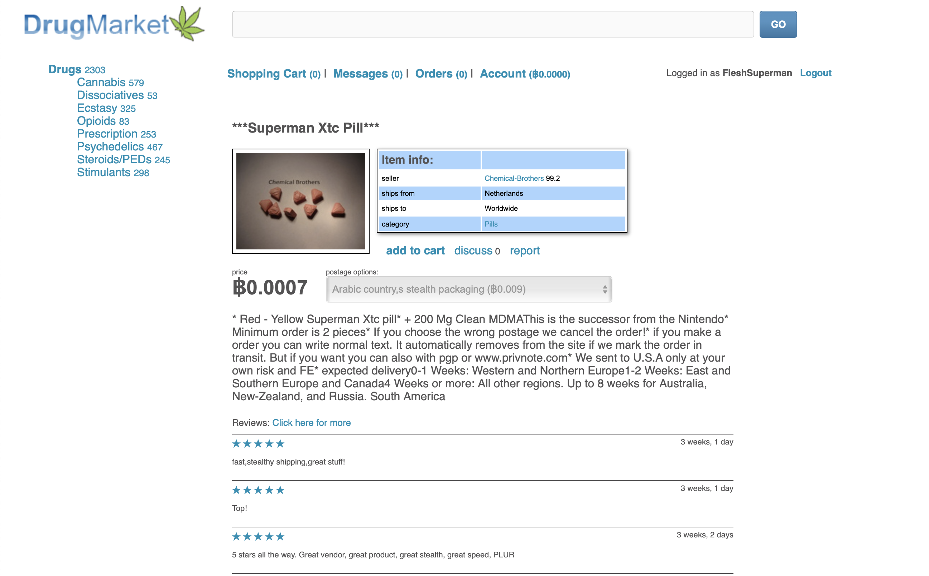
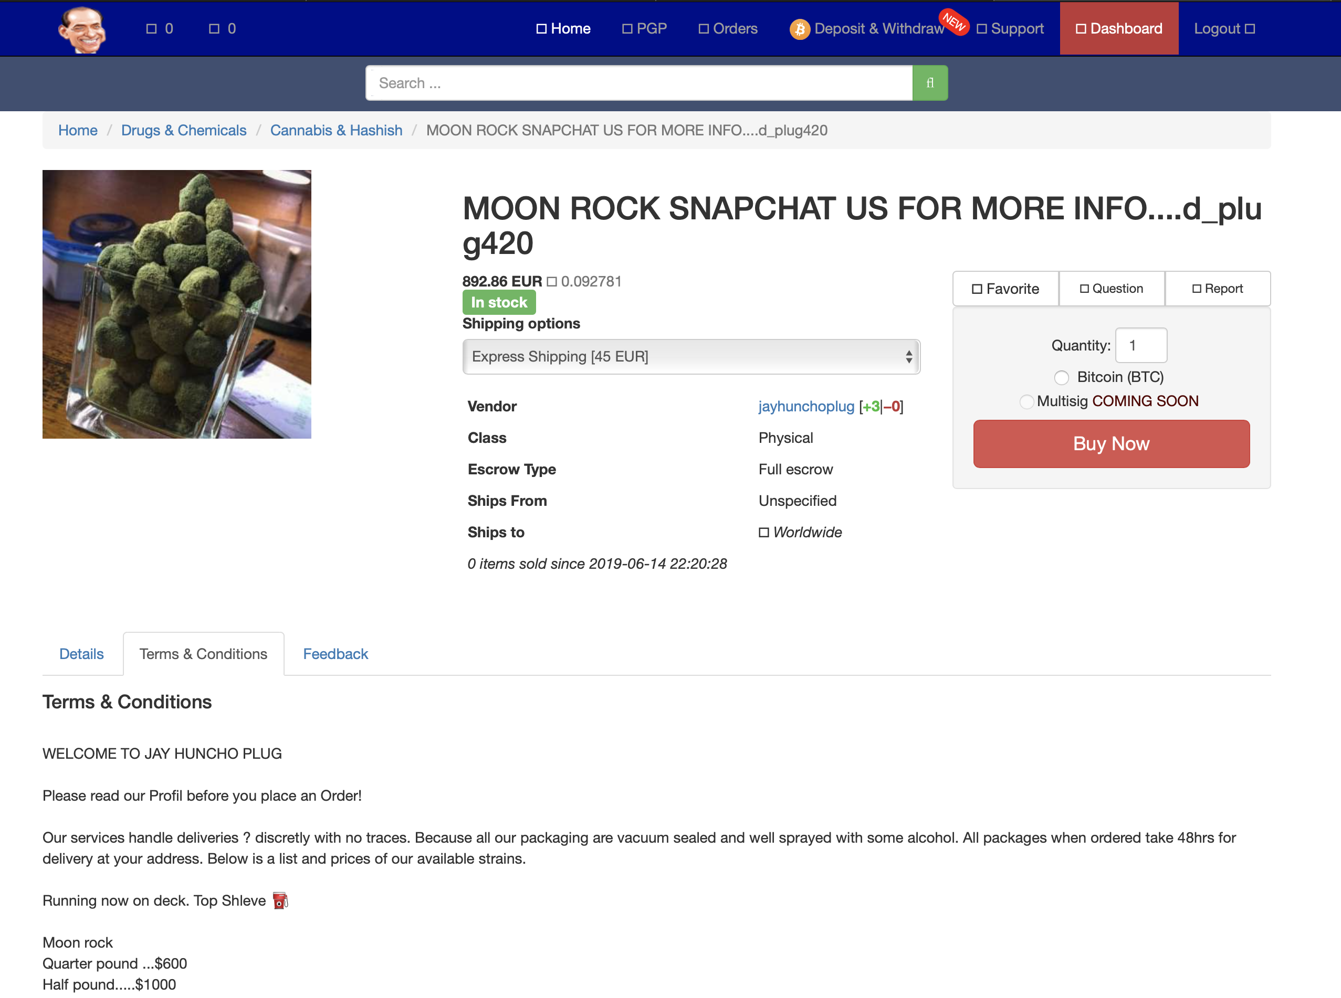
Proces in short
EXPORTED HTML
STRUCTURED JSON

Slide 11
Current focus
A.
Receiving Data
&
Extract Data
B.
Create multi-market scraper
C.
Create API
(gain insights)

